Slide 1

House Price Prediction
Submitted by
Meenu G

Slide 2
Business Problem Understanding
Problem Statement
Buying or selling a house is not just about location or square footage. Many other factors influence a property's value like condition, age, renovations, and even whether it has a waterfront view. Suppose you're planning to sell your home but aren't sure what a fair asking price should be. In most cases, you would compare it to similar properties in your area to get an estimate. This project aims to take that a step further by using historical housing data to understand what truly drives house prices.
Scope and Objective
The primary objective of this project is to analyze historical real estate data from 2014–2015 to uncover the key drivers of house prices. The scope includes:
Exploratory Data Analysis : To identify trends, detect anomalies, and prepare the dataset for modeling.
Clustering Techniques: To segment properties into meaningful groups, revealing distinct market patterns.
Predictive Modeling: To estimate house prices based on influential features and improve decision-making accuracy.
The resulting insights are designed to empower buyers, sellers, and real estate professionals with data-backed strategies for smarter property decisions.

Slide 3
Business Problem Understanding
(contd…)
Features Analyzed –Total 22
Numerical features - price, room_bed, room_bath, living_measure, lot_measure, ceil, quality, ceil_measure, basement, living_measure15, lot_measure15, total_area, sight, condition
Categorical features - coast, furnished
Others – cid, dayhours, lat, long, zipcode, yr_built, yr_renovated
Buyer Preferences and Demand
Most buyers prefer 3-bedroom homes, followed by 4 and 2-bedroom options.
Over 60% of listings fall under mid-sized homes (1000–2500 sq ft), indicating the most in-demand segment.
1 or 2-level homes are most commonly sold, suggesting buyers prefer simpler structures.
More than 90% of homes are of quality rating 7 or above, showing buyers prefer standard to higher-quality properties.
Around 80% of homes are unfurnished. Furnished homes are usually larger and of better quality.
Only 10% of homes had in-person viewings (sight > 0), showing that most buyers decide without visiting the house.
Property Characteristics and Market Distribution
Price has a strong positive correlation with:
  living_measure, ceil_measure, living_measure15 (size-related),quality, furnished (furnishing status), and room_bath
Living area (sq ft) increases house price, while lot size does not show strong correlation.

Slide 4
Business Problem Understanding
(contd…)
Higher quality homes are priced significantly more, confirming a strong quality-price relationship.
Coastal view properties are less than 1% of listings but are priced much higher.
About 95% of homes are not renovated, suggesting limited added value from renovations in this dataset.
Condition ratings are mostly 3 to 5, but unlike quality ratings, they do not show strong correlation with price.
More bedrooms generally mean a higher price, but not always. Among homes with 3 to 5 bedrooms, prices vary widely. This shows room size and quality matter more than just the count.
Three distinct property clusters could be identified in the housing market, each showing clear differences in features such as living and lot size, furnishing, ceil, quality, and bedroom and coast view:
Cluster | Living Area | Lot Size | Furnished | Ceil (most common) | Quality | Bedrooms (mode) | Coastal View | Comment
0 | Large (~2880 sqft) | Very Large (~255k sqft) | 44% furnished | 2 floors (48%) | 6–8 | 3–4 | None | Smallest group. Large homes on varied lots. Mid-high quality.
1 | Compact/mid sized (~1607 sqft) | Small (~8.9k sqft) | 1.6% furnished | 1 floor (62%) | Mostly 7 | 3 | None | Largest group. Compact homes on smallest lots. Mid-quality.
2 | Spacious (~3083 sqft) | Medium (~15k sqft) | 58% furnished | 2 floors (70%) | Mostly 9–10 | 3–4 | Homes with coastal view present (<1%) | High-end homes with larger lots. Only cluster with coastal view.

Slide 5
Modelling Approach Used & Why
Model | Set | Root Mean Squared Error | Mean Absolute Error | Adj. R-squared | Mean Absolute Percentage Error | R-squared | Residual Spread Assessment
 |  | (RMSE) | (MAE) |  | (MAPE)
XGBoost Regressor | Train | 88340.624 | 63134.410 | 0.937 | 13.728 | 0.937 | Residuals tighter in middle, some variance at extremes -- Slightly Overfit. Best performing model with highest test and train R-squared and acceptable level of MAPE
 | Test | 164407.181 | 91143.195 | 0.826 | 17.242 | 0.826
Random Forest Regressor | Train | 65842.943 | 42018.841 | 0.965 | 8.753 | 0.965 | Residuals spread wider in test set -- Highly overfitting. Strong drop in test performance.
 | Test | 193788.446 | 117270.170 | 0.758 | 23.981 | 0.758
Polynomial Regression | Train | 0.292 | 0.232 | 0.686 | 1.790 | 0.686 | Residuals well-distributed, small bias-- good fit. Consistent performance across train and test sets
 | Test | 0.296 | 0.234 | 0.699 | 1.802 | 0.700
Ridge Regression | Train | 0.309 | 0.247 | 0.648 | 1.896 | 0.648 | Slight curvature of residuals -- good fit. Stable performance across train and test
 | Test | 0.309 | 0.246 | 0.671 | 1.894 | 0.672
Linear Regression | Train | 0.309 | 0.247 | 0.647 | 1.897 | 0.648 | Residuals well-distributed and no bias. Good fit. Consistent performance across train and test sets
 | Test | 0.309 | 0.246 | 0.671 | 1.894 | 0.671
LASSO Regression | Train | 0.309 | 0.247 | 0.647 | 1.897 | 0.648 | Residuals showing clear pattern. But the performance is stable across train and test sets
 | Test | 0.309 | 0.247 | 0.647 | 1.897 | 0.648
ADABoost Regressor | Train | 221760.114 | 152952.723 | 0.604 | 33.417 | 0.604 | Weak learner, noisy fit
 | Test | 246181.588 | 158919.200 | 0.609 | 34.058 | 0.610
SVM Regressor | Train | 362460.091 | 218142.531 | -0.059 | 42.175 | -0.058 | Severely underfit — fails to capture structure
 | Test | 405257.831 | 228799.787 | -0.060 | 43.139 | -0.056

Slide 6
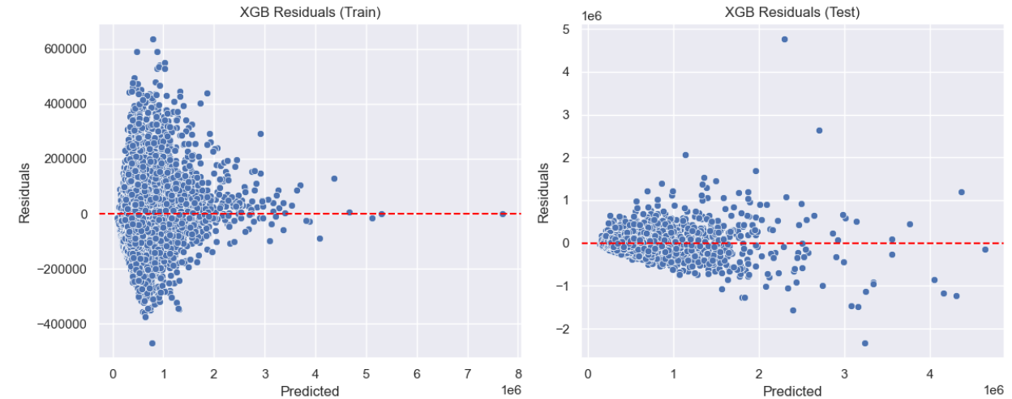
Modelling Approach Used & Why
(contd)…

Slide 7
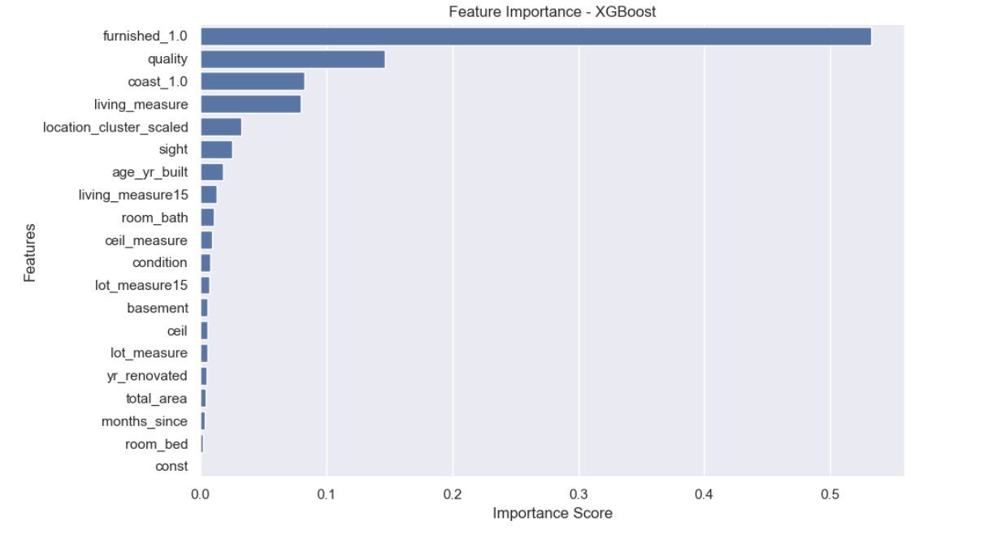
Insights from Analysis
Important Features
Most important feature is furnishing- contributing the most to the predictions
Other top contributors are quality, coast, living measure
Location , number of sightings, age of house, living measure 15 has moderate influence
Features with relatively low impact: bathroom count, ceil measure, condition, lot measure 15, basement, ceil, lot measure, year of renovation, total area, months since selling, bedroom count.

Slide 8
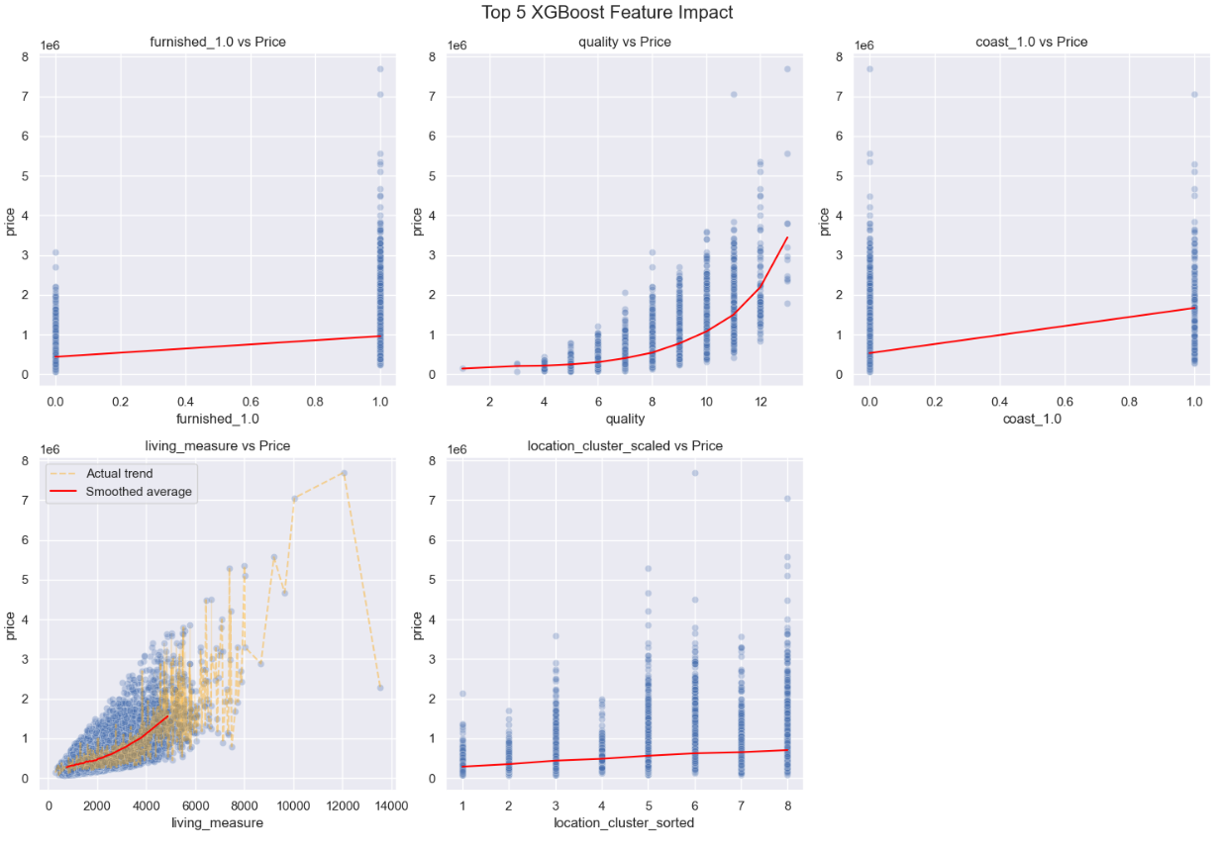
Insights from Analysis
(contd..)
1. furnished_1 vs Price
Binary feature (0 = unfurnished, 1 = furnished)
Furnished homes command higher prices
2. quality vs Price
Strong non-linear upward price trend: price rises sharply after quality > 5
Suggests high-quality homes are more valuable
3. coast_1 vs Price
Binary feature,(0 = no coastal view, 1= with coastal view) houses with coastal view are priced higher
Despite moderate feature importance, actual price impact is weak
4. Living measure vs Price
Clear upward curve for average price: larger homes tend to have higher prices
Actual price trend(yellow line) shows variability and outliers
Strong predictor –price increases more steeply beyond ~3000 sqft.
5. Location Cluster vs Price
Mild upward trend for prices showing moderate impact on price
Certain locations priced higher than others.

Slide 9
Recommendations
For real estate sellers:
Offer furnishing packages or partnerships with interior designers to boost the price. Encourage sellers to furnish homes.
Highlight quality ratings in listings, especially for high-end buyers. Segment the listings based on quality rating – eg. Premium, Executive, Standard
Educate the sellers on upgrades that improve the quality ratings
Promote properties with good coastal access. Reassess pricing strategy for coastal homes based on actual demand , quality and closeness to other amenities.
Highlight spacious houses with floor plans and virtual tours. For small homes, emphasize smart layout and multi-use spaces.
Use size-based pricing brackets to guide buyers – eg: Affordable homes with best value under 2000 sqft
Re-assess the price of houses based on the location – use the location cluster insights from the model.
For buyers:
Budget conscious buyers can consider unfurnished homes and furnish gradually.
Negotiate furnishings – some sellers may include it to close the deal faster
Avoid overpaying for lower-quality houses. Consider quality 6 – 8 rating for a standard quality house.
Larger homes cost more, but focus on layout efficiency also.
Enquire about location based price trends from real estate agents to decide on the location

Slide 10
Thank you

